Slide 1
Introduction to Arduino Microcontrollers
...and how they can be used in Amateur Radio
Andrew Rohne, KE8P
October 18, 2013

Slide 2
Presentation Outline
Basics
Terminology
Hardware
Amateur Radio Applications
Getting Started
More Information

Slide 3
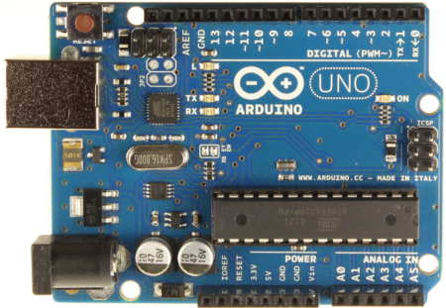
What is it?
Notes:
The Arduino is a programmable hardware board that runs an 8-bit 16 Mhz microcontroller with a special bootloader that allows users to upload programs to the microcontroller. It has digital input pins for input from switches and output to things like LEDs (and two of those pins are for serial communication). It also has analog pins to accept inputs from voltage-based sensors.

Slide 4
Open Source
Open Source Hardware
Open Source Bootloader
Open Source Development Kit
Community Driven Support
Notes:
The Arduino system is open source - all hardware (made by Arduino distributors) has the schematics and PCB layouts available online. Because of this, there are Arduino Compatibles out there – Mintduino (made by Make, goes into a mint tin), Diavolino (made by evil mad science).
The bootloader is what runs on the chip before the program is run. It boots the chip and executes the program.
The development kit - what you use to program an Arduino board - is also available online. It is free, open-source.
Because of this, there is a large community of users that will help. The main Arduino site includes a very extensive forum, plus Internet searches will reveal help from Arduino Distributors like Sparkfun Electronics, Adafruit Industries, Make Magazine, and others.

Slide 5
Terminology
I/O Board - main microcontroller
Shield - add-on boards
Sketch - the program
Sensor - components (thermistors, etc.)
Modules - serial data (GPS module, etc.)
Notes:
The primary terms you need to know are what the I/O Board is, what a shield is, and what a sketch is.
The I/O Board is the "brains" of the operation. You program these from your computer.
A Shield is a device that plugs into an I/O Board. These extend the capabilities of the I/O Board.
A Sketch is a program written for the board and shields.

Slide 6
What do these do?
Digital IO (LEDs, switches)
Analog IO (resistive sensor data)
Serial Connection (Sensors, GPS, etc)
Program from your computer
Your limit is only your creativity!
Notes:
The digital inputs and outputs can sample a digital high or low signal and can sample voltage. These can be used with resistance-based sensors, such as thermistors, force sensors, light sensors, etc.
The Arduino runs on an ATMega328 processor, which is an 8 bit microprocessor. Certain Arduinos have 32 bit microprocessors.
Serial inputs can input or output a stream of data. This is useful for things like GPS, data logging.

Slide 7
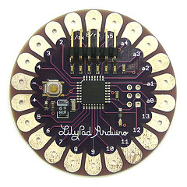
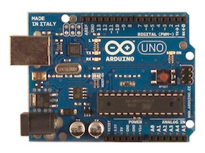
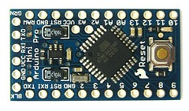
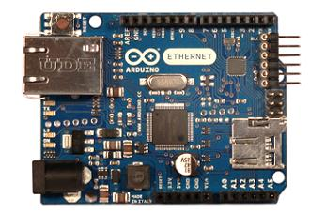
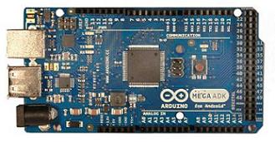
Arduino I/O Boards
Notes:
These are some of the various Arduino I/O boards. Clockwise from the top left is an Uno (great starter board), a Lilypad (normally used for clothing applications), a Pro (very small), a Mega (very powerful), and an Ethernet Board.
These boards all have analog and digital input/output. The Uno and Mega have the USB programming interface included - the other boards need an additional board to plug in (or solder in) to program.
There are more boards than just these!
The prices for these run as low as $20, as high as $60. The Uno is $30, which is generally the best place to start.

Slide 8
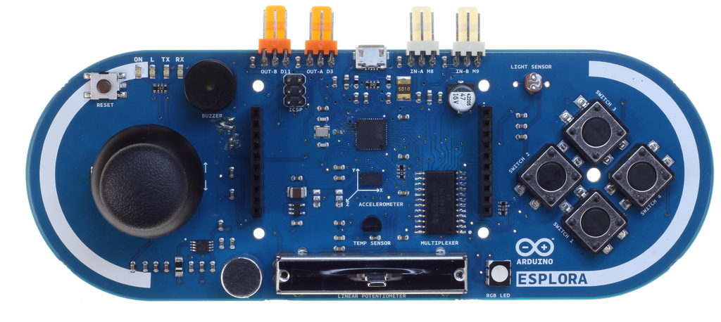
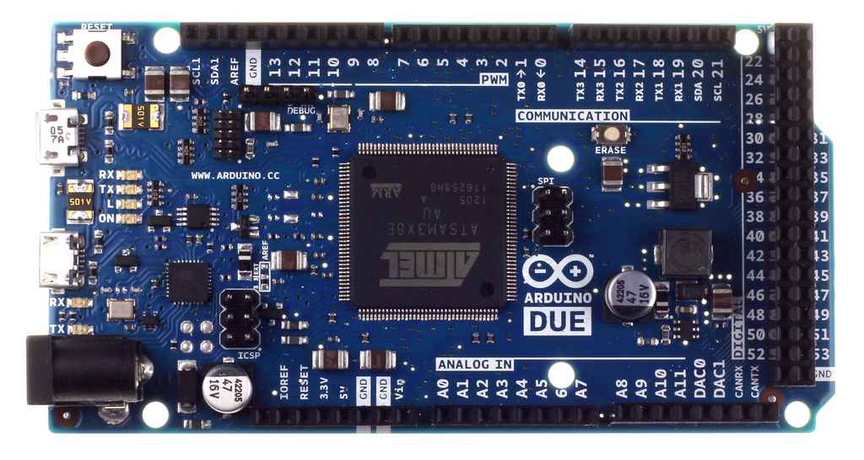
More Boards
15 current boards
Notes:
Upper: Arduino Esplora, $65 at Radio Shack. Lower: the Due, a 32 bit Arduino board.

Slide 9
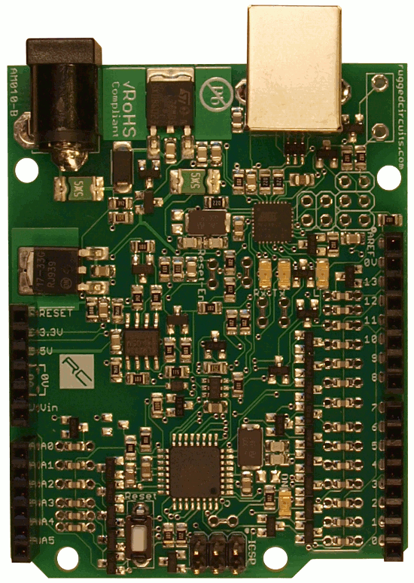
Compatible Boards
These are two of MANY!
Notes:
This is the Diavolino and the Ruggeduino. The Diavolino is a low cost board kit ($12 at Micro Center). The Ruggeduino is built for beginners and has fuses and other limiting components to nearly eliminate the possibility of damaging the board.
These are two of many. Since Arduino is open, anyone can make boards, and many have extended boards for special purposes, such as robots, flight simulation, video games, radio control vehicles, and for prototyping.

Slide 10
Compatible Boards

Slide 11
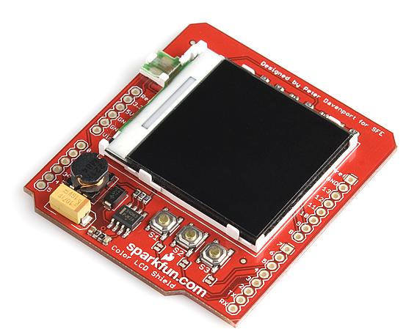
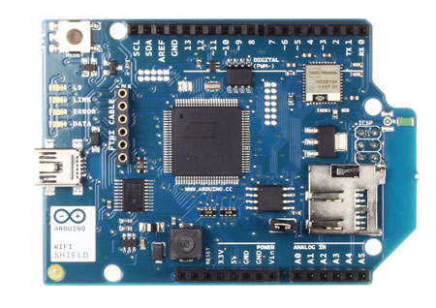
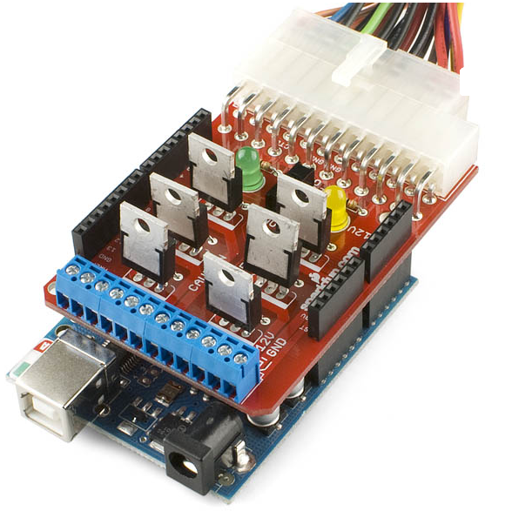
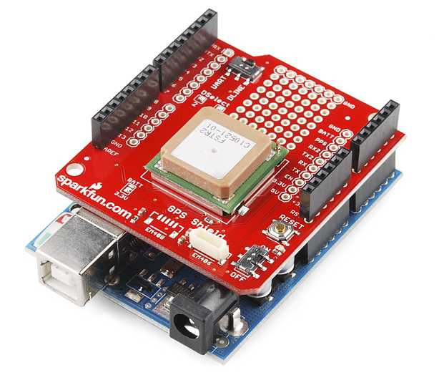
Shields
Notes:
Shields connect to the I/O board to extend it's functionality. Hundreds of shields are available, and you can make your own.
Starting from the upper left going clockwise:
Wireless Network Shield
Color LCD Shield
Power Driver Shield (connects to a computer power supply).
GPS Shield
Shields can run as low as $15, as high as $200.
Bluetooth $40-$65
LCD: $40
GPS: $80
Power Driver: $20

Slide 12
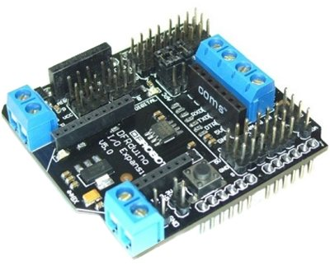
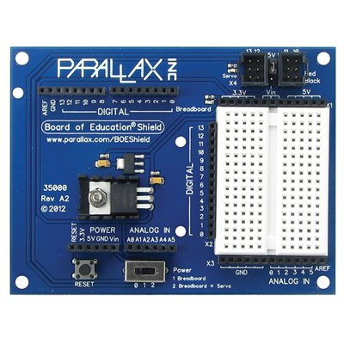
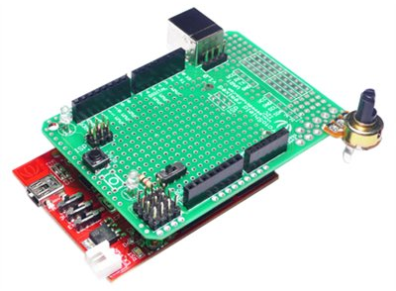
And more shields…

Slide 13
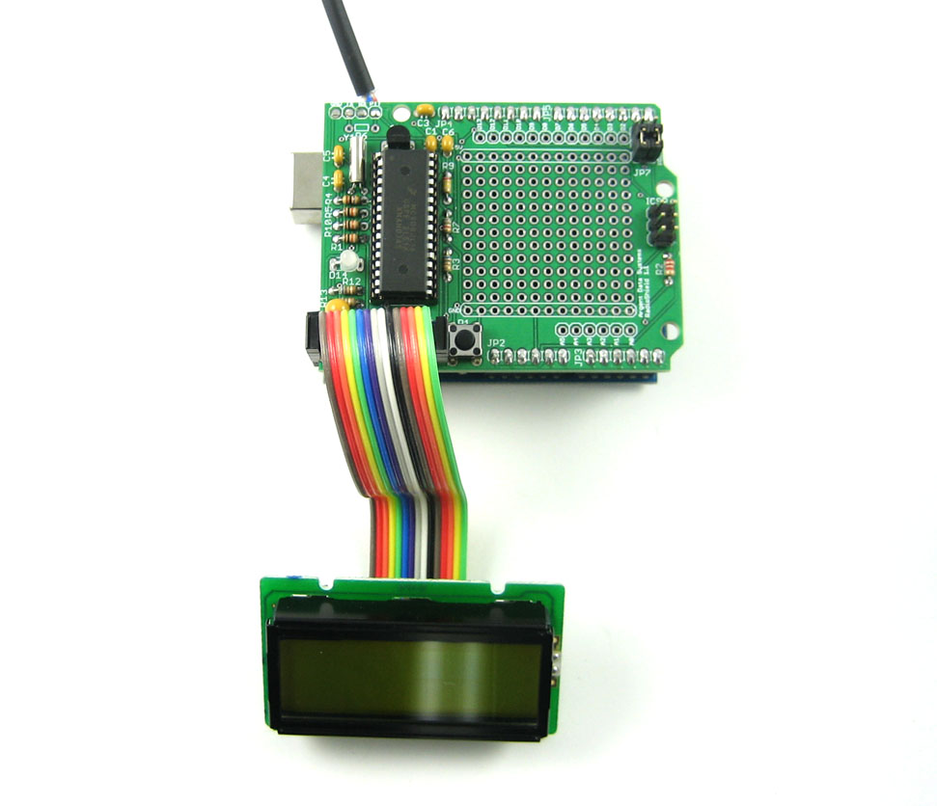
Even more shields!
APRS Shield

Slide 14
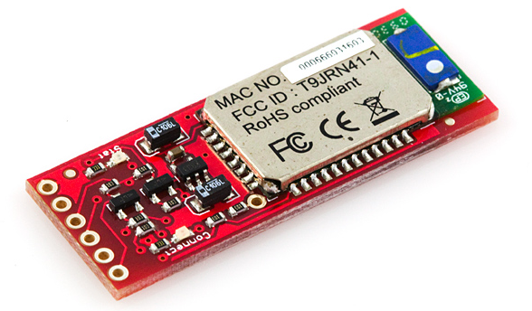
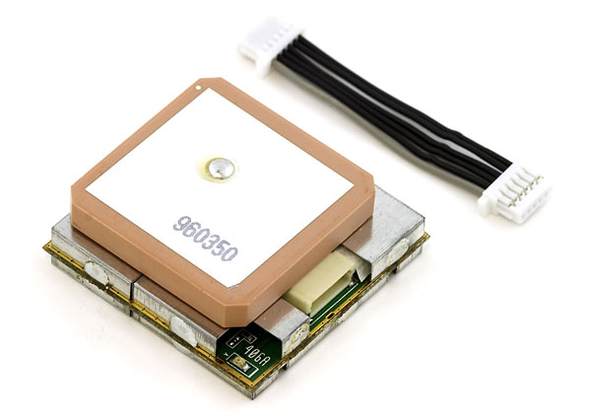
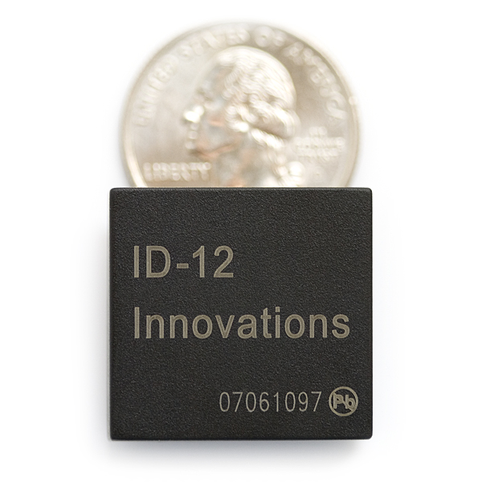
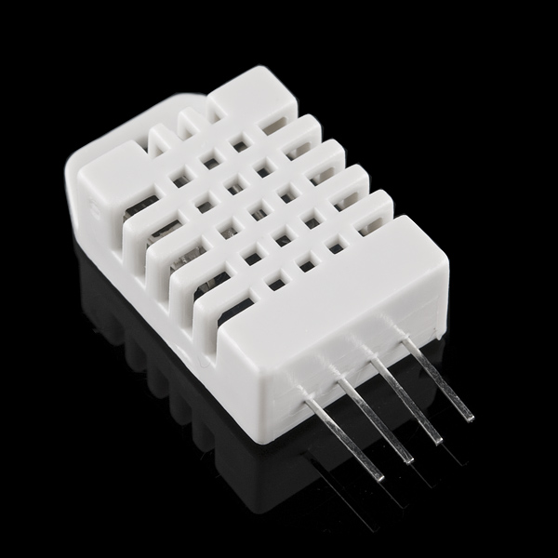
Modules
Bluetooth Module
GPS Module
Temperature & Humidity Sensor
RFID Module
Notes:
Modules send serial data strings to the Arduino.

Slide 15
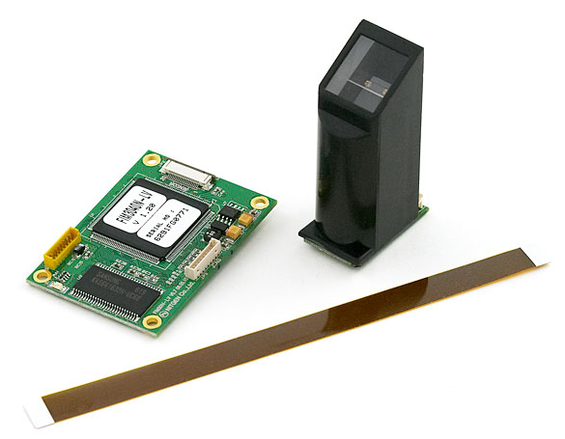
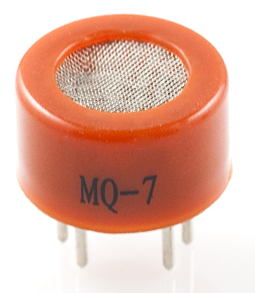
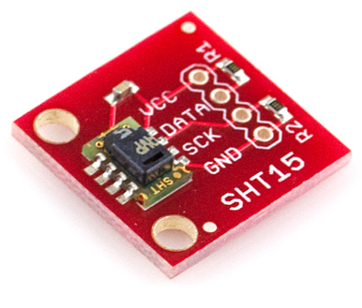
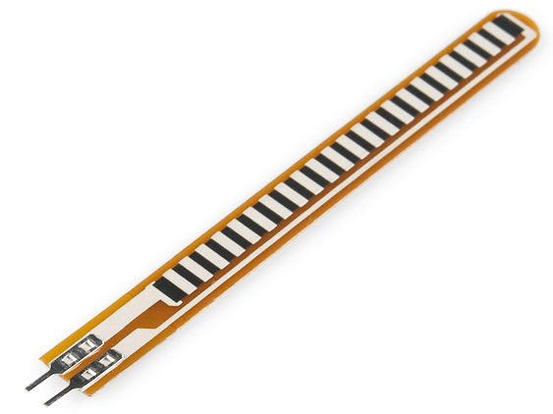
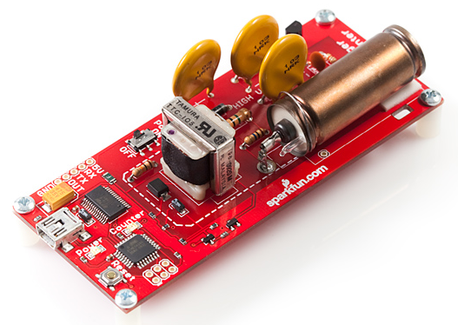
Sensors and Modules
Gas Sensor
Temp & Humidity
Fingerprint Scanner
Flex Sensor
Geiger Counter
Notes:
Shields aren't the only way to extend an Arduino board - you can hook sensors to it! These are some of the hundreds (if not thousands) available. Many of these are not made specifically for Arduino - some sensors, such as thermistors, you can get from Radio Shack and wire them in!
Sensors can run as low as $0.95 (for a thermistor or light sensor) to $150 (Geiger counter sensor)

Slide 16
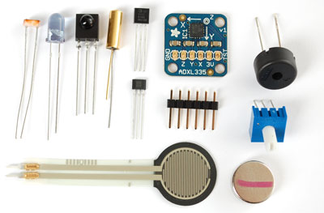
Sensors
Photoresistor, infared, force sensitive resistor, Hall effect, Piezo, tilt sensor..

Slide 17
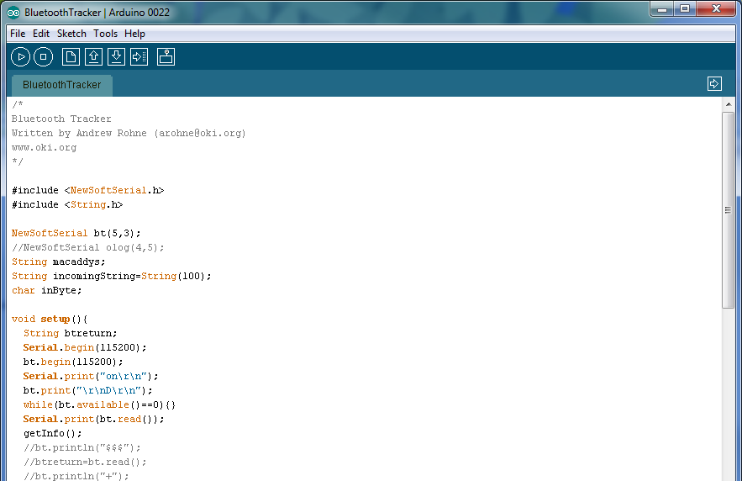
Sketches
Includes
Globals
void setup()
void loop()
Notes:
Sketches are built in the Arduino Development Kit. The dev kit is free and open source. It is basically a simplified C++ processor.
The sketch is then uploaded to the Arduino I/O board and will run.

Slide 18
Amateur Radio Applications

Slide 19
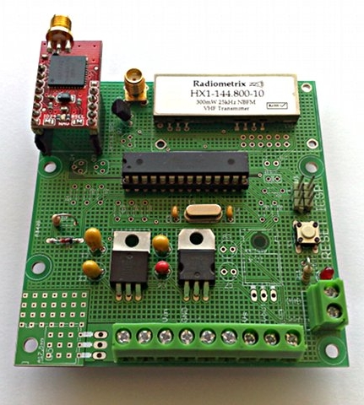
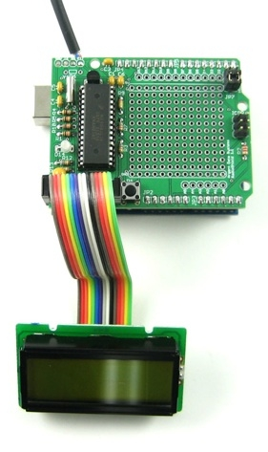
Applications - APRS
Trackduino
Argent Data
Notes:
With the Argent Data Shield, you can use an Arduino to feed audio to an HT as well as gather GPS coordinates, even OBD-II or CAN-BUS information through it.

Slide 20
Rig Adjustment for Doppler Effect
Arduino Rig Control
Adjusts rig for Doppler shift
Video on YouTube (link in notes)
Notes:
The video is at http://www.youtube.com/watch?v=TP_fq_frqKw

Slide 21
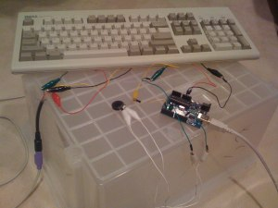
Morse Code Keyboard

Slide 22
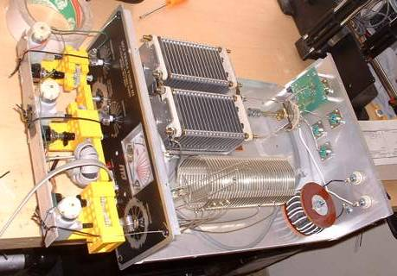
Arduino Controlled Tuner

Slide 23
Others
Morse code keyer
Attach to DDS (frequency synthesizer) and mixer
QRP CW/QRSS Transmitter
Antenna switching
Weather stations
Notes:
The video is at http://www.youtube.com/watch?v=EfKVsrWgeCM&feature=youtu.be

Slide 24
Getting Started
Sparkfun Getting Started in Arduino Kit ($95)
Sparkfun Starter Kit for Arduino ($60)
Adafruit Experimentation Kit ($85)
Adafruit Starter Pack ($65)
OR
Arduino Board (Uno $20 or Mega $35) +
Breadboard, wires, components, etc.

Slide 25
With Starter Sets
Book is open source!

Slide 26
Other Open Source Hardware
Raspberry Pi

Slide 27
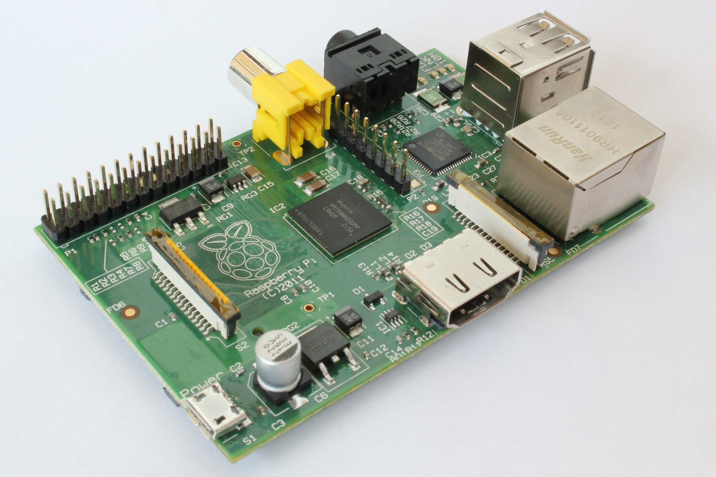
Raspberry Pi
Notes:
The Raspberry Pi is a partially open (no board layout) full computer. It runs a 700 MHz ARM processor and Linux on an SDCard. 2 USB ports, an Ethernet port, an HDMI port, a composite video port, an audio output port, and a bunch of GPIO pins that can be used for digital input and output.
These cost $35 and are so far being used for WSPR, SDR, POCSAG Paging, a DX “watcher”, and an APRS TNC

Slide 28
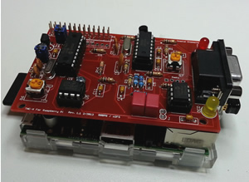
Pi TNC
Notes:
Source: http://www.tnc-x.com/TNCPi.htm. This is a $40 board.

Slide 29
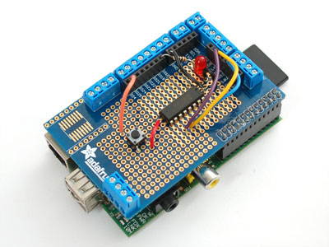
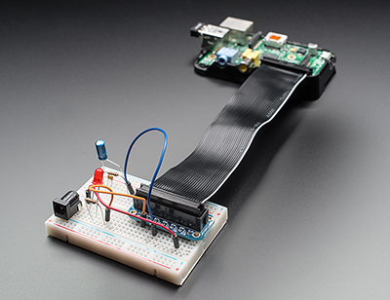
Raspberry Pi Accessories
Pi Plate
Pi Cobbler
Notes:
The Pi Plate fits on top the Pi and makes for easier access to the pins on the Pi. The Pi Cobbler does a similar function – makes for easier access, but it is made to connect to the Rpi via a ribbon cable and plugs into a breadboard.

Slide 30
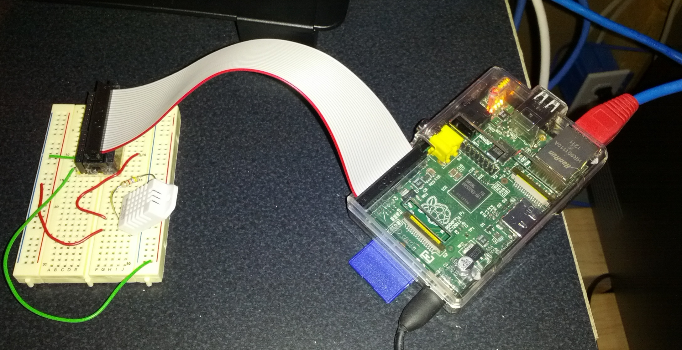
Temperature/Humidity Sensor

Slide 31
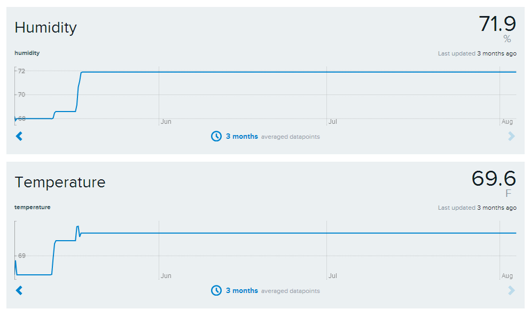
Temperature/Humidity Sensor
Notes:
Apologies for the flatlined charts – my Rpi flatlined just under 3 months ago.

Slide 32
Other Open Source Hardware
Beaglebone Black

Slide 33
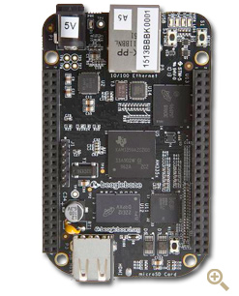
Beaglebone Black
Beaglebone makes several boards
Black is the newest, $45 Pi competitor
A little faster than the Pi, 2GB onboard storage, more input/output pins

Slide 34
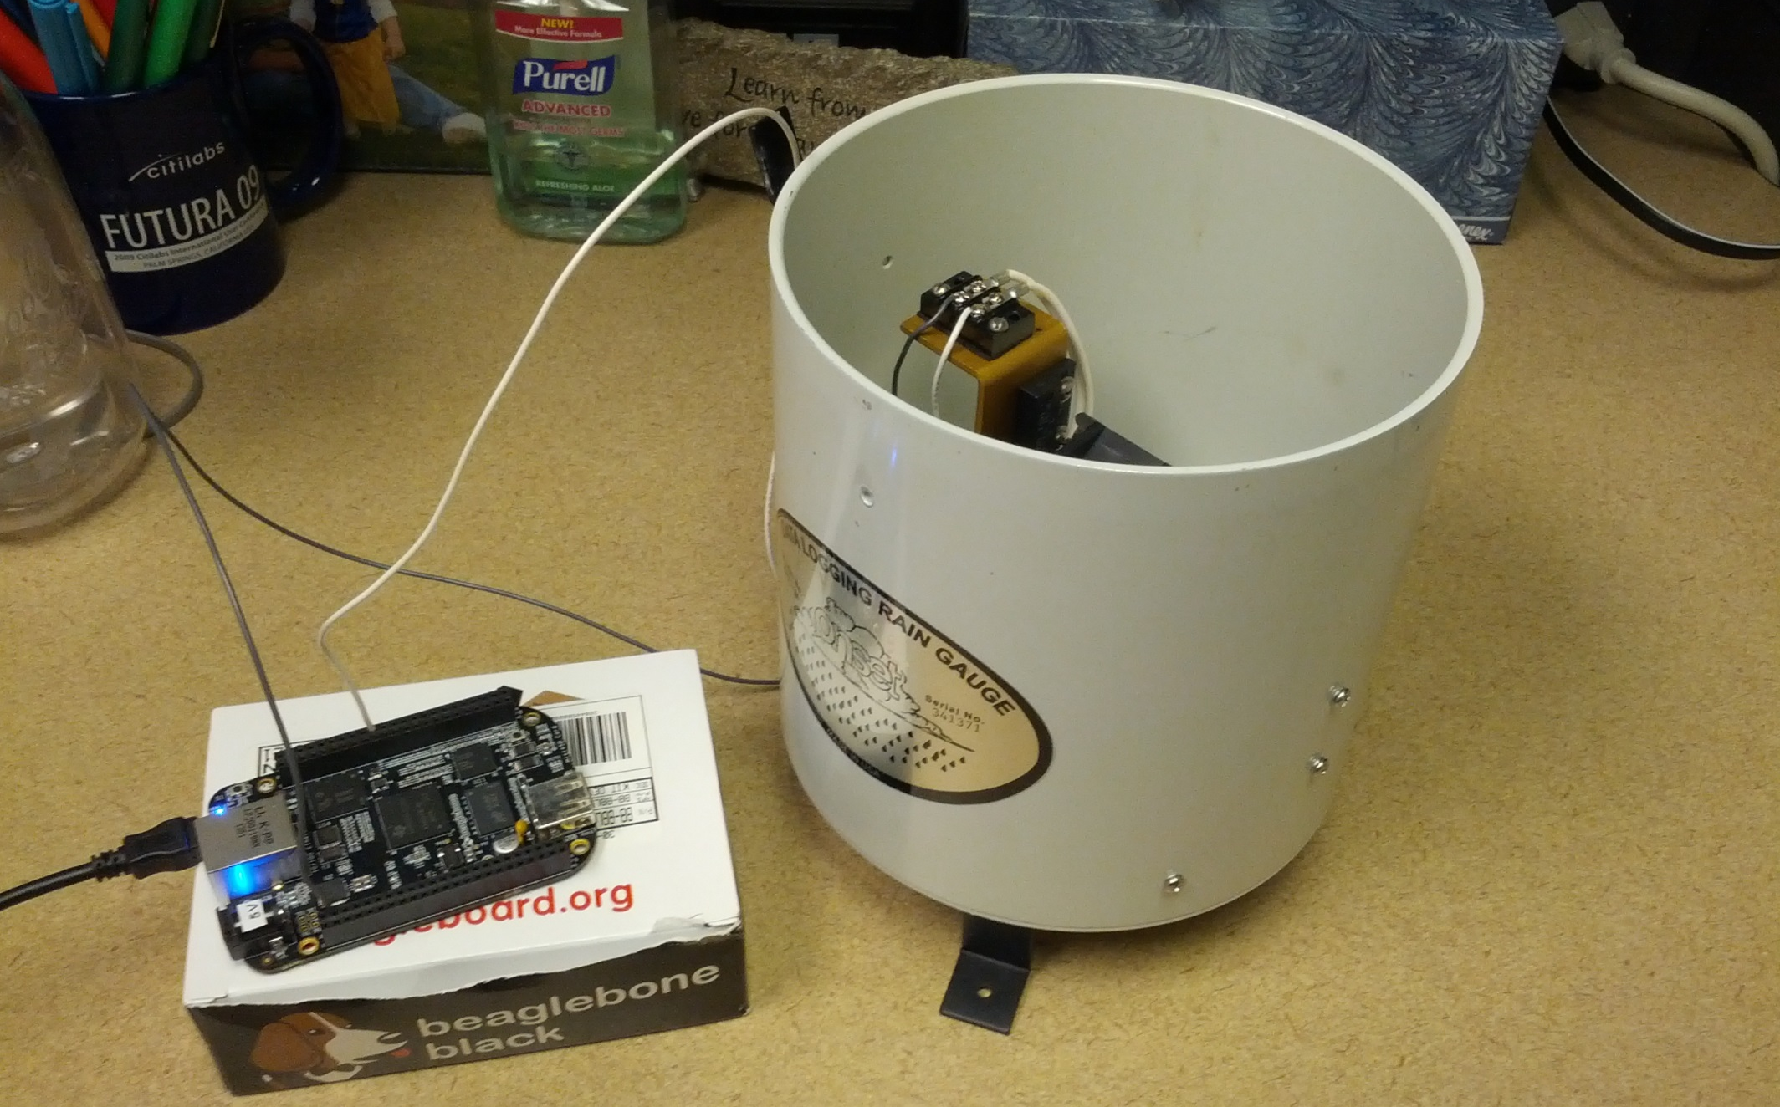
Beaglebone Black WX Station
Notes:
Also: DC-to-Daylight SDR, hopefully to be announced at Dayton 2014.

Slide 35
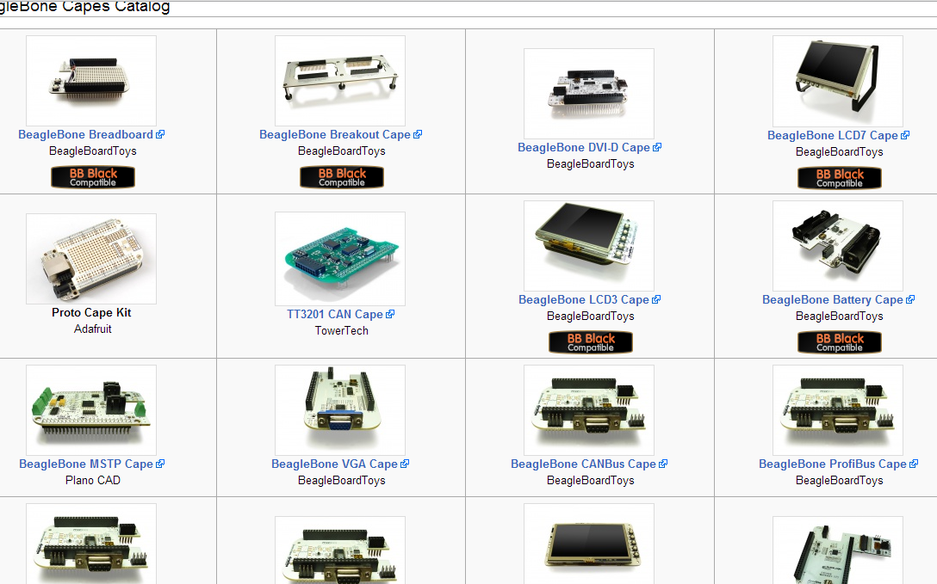
“Capes”
Notes:
Capes are shields for a beaglebone

Slide 36
TI Launchpad

Slide 37
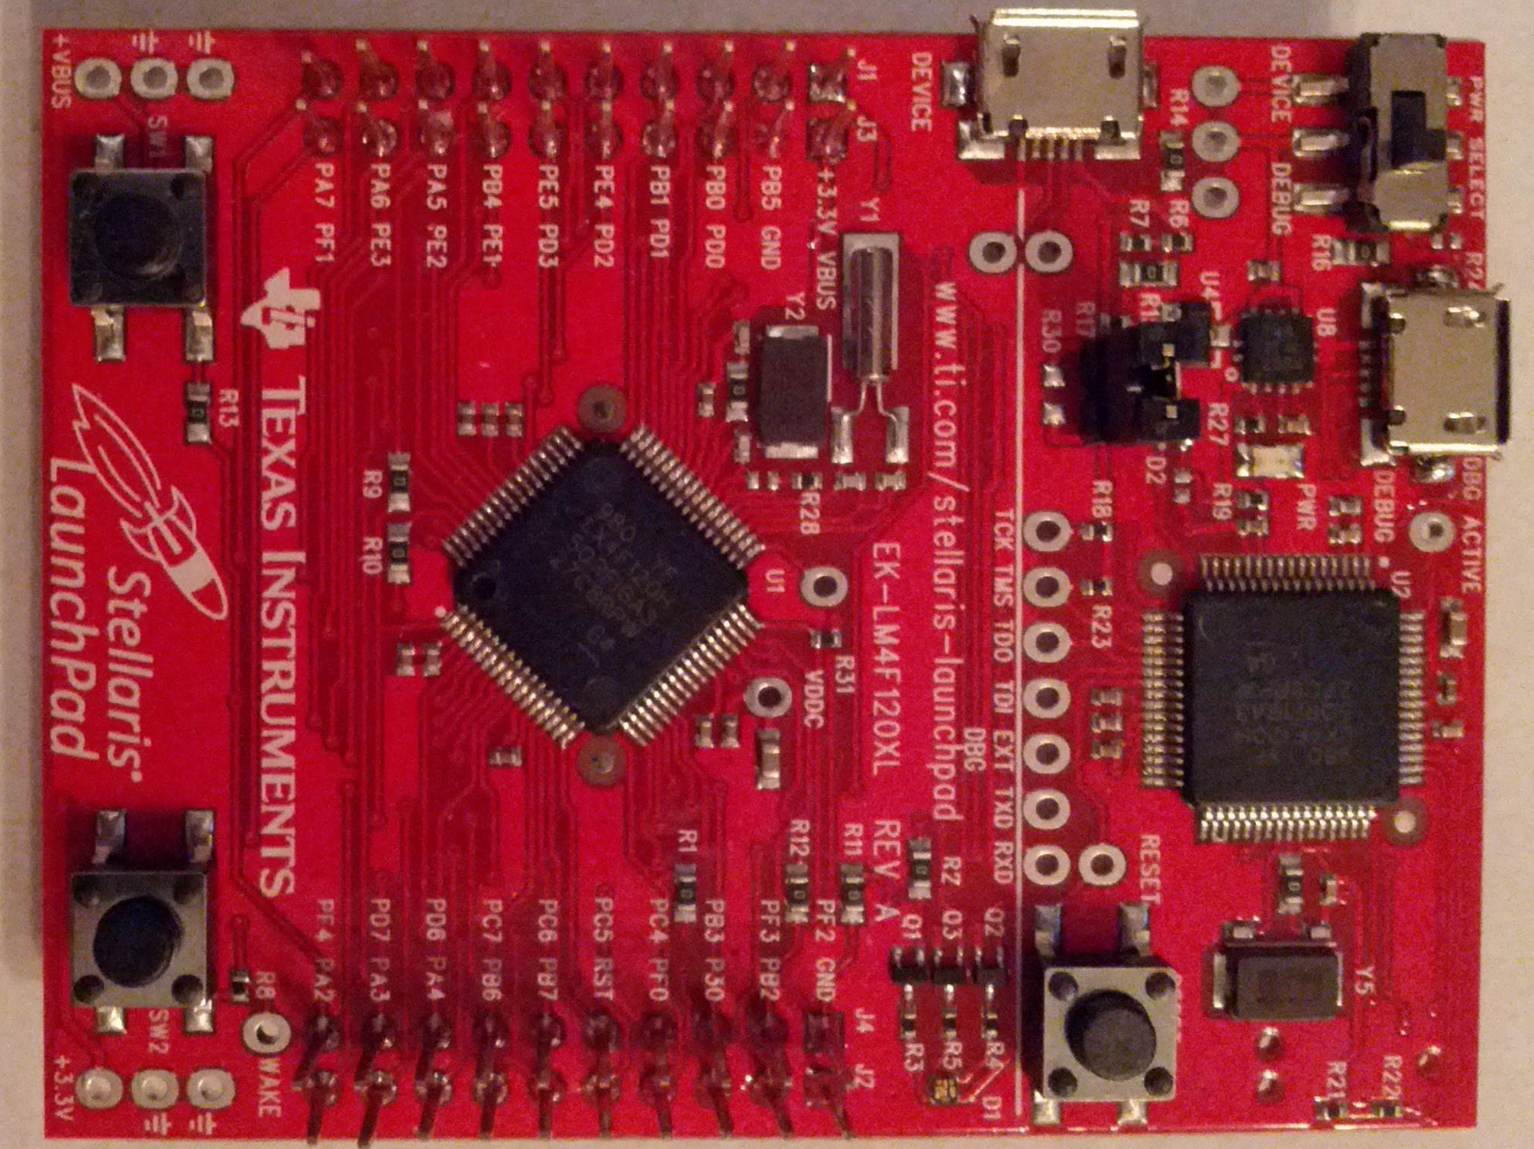
TI Launchpad
Notes:
This is an evaluation board that has an 80 Mhz 32-bit ARM processor. It costs $13 from Texas Instruments. There’s been a little bit going on with it, but not anything ham radio that I’m aware of other than an Iambic keyer.
This had an introductory price of $5, which helped it’s adoption among hackers and makers.

Slide 38
Chipkit

Slide 39
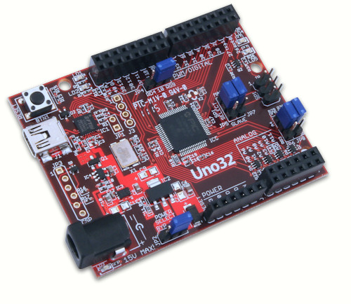
Chipkit Uno32

Slide 40
Chipkit Uno32 and Max32
Pinouts compatible with Arduino Shields
Use PIC32 microprocessors
Asynchronous Processor
Better for counting applications

Slide 41
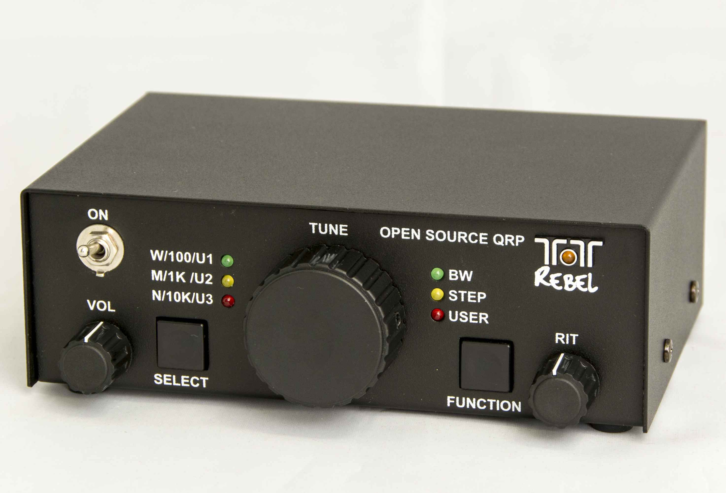
Ten Tec Rebel 506

Slide 42
Ten Tec Rebel 506
Open Hardware
Schematics and board layout on Yahoo Group
Open Software
Source uploaded to Yahoo Group
Ten Tec will support rigs with official firmware
Extendable!
~$200
Notes:
http://groups.yahoo.com/group/TenTec506Rebel/

Slide 43
Resources
Links to presentation and everything mentioned today:
http://ke8p.us/go/qcen
Andrew Rohne, KE8P
ke8p@ke8p.us
Twitter: @KE8P
Web: http://ke8p.us
Notes:
Don’t forget the next slides about TSH!

